Slide 1
Sales Method Analysis and Recommendations
Pens & Printers
Presented to the Sales Team

Slide 2
Overview
Evaluate the effectiveness of different sales methods
Identify strategies to optimize team efforts and maximize revenue
Provide actionable recommendations to enhance sales performance

Slide 3
Summary of Work Undertaken
Data Cleaning:
Corrected inconsistencies in the sales_method column.
Imputed missing revenue values based on the mean of the respective sales method.
Standardized text fields for uniformity.
Exploratory Data Analysis:
Assessed revenue trends and customer metrics.
Evaluated efficiency metrics such as revenue per minute of effort.
Efficiency Analysis:
Compared performance metrics across sales methods to identify the most effective strategies.

Slide 4
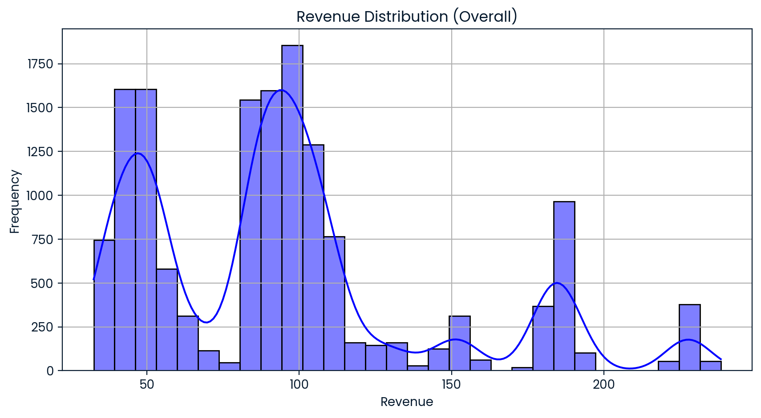
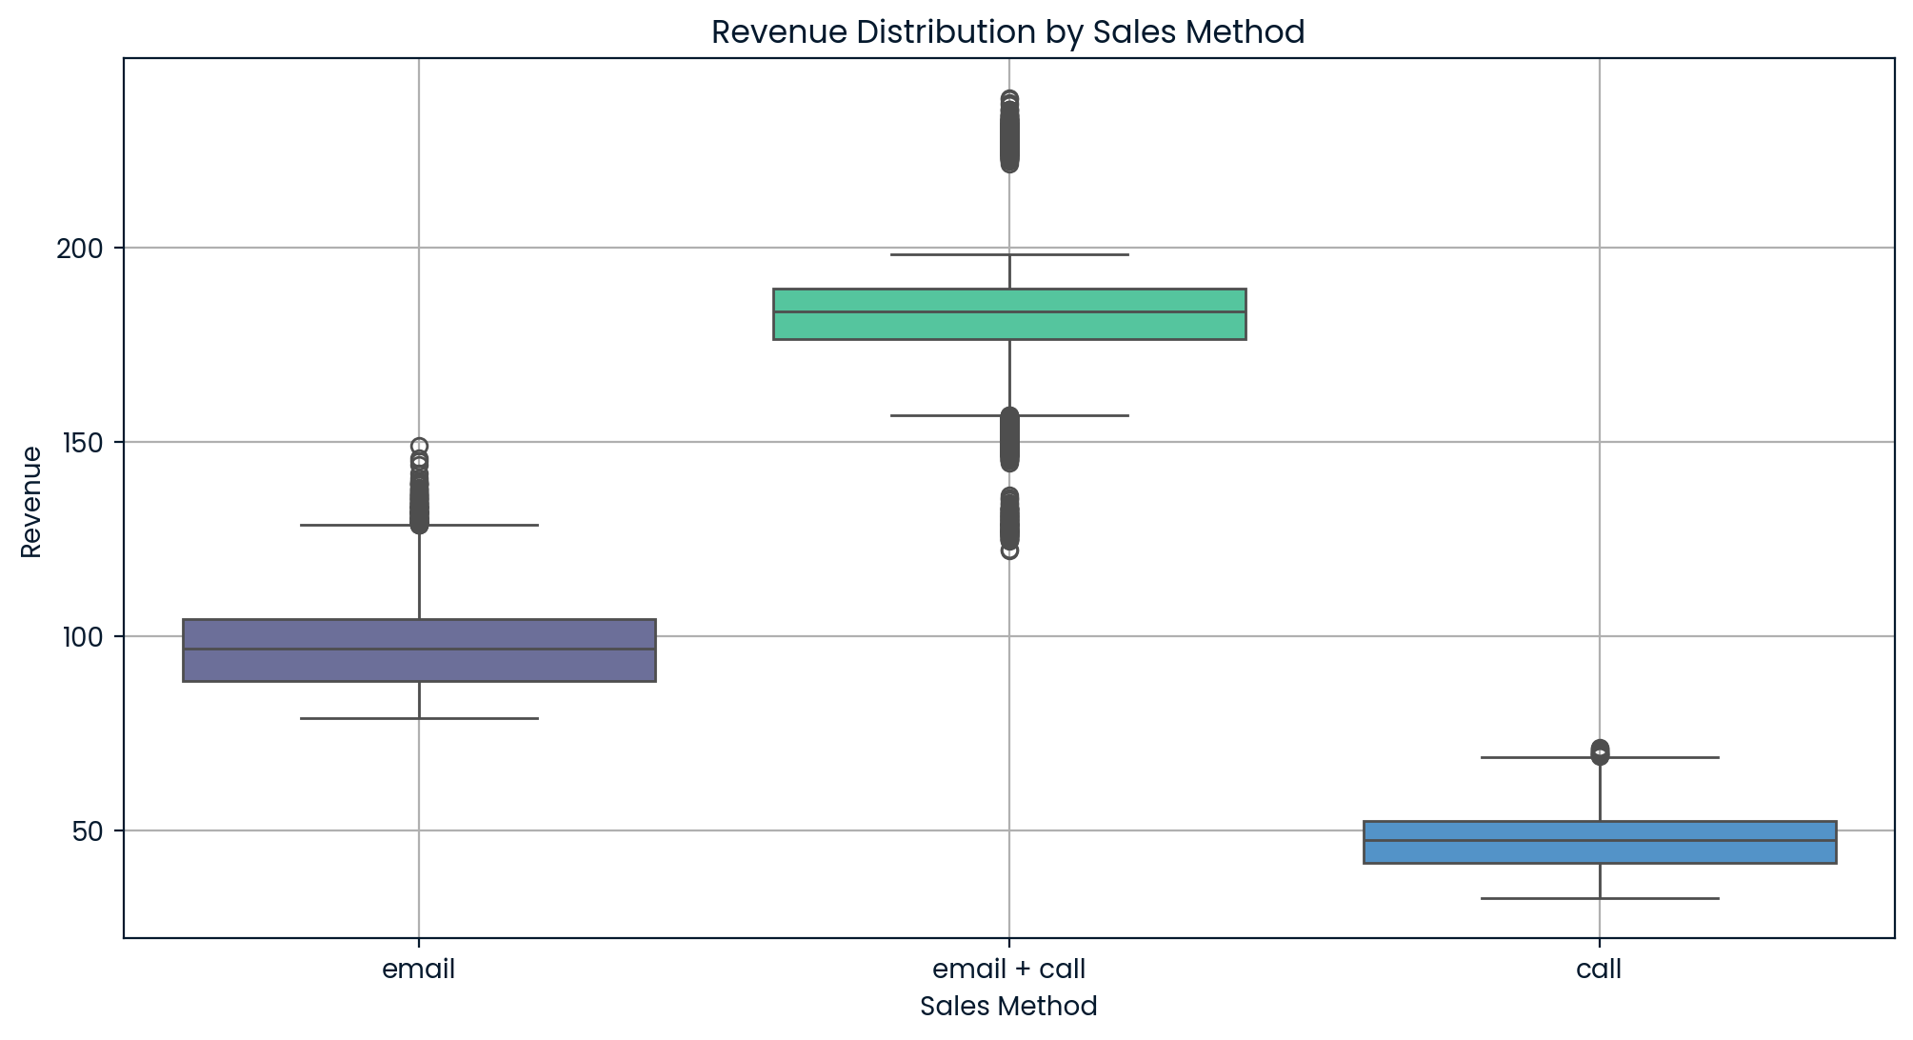
Key Findings
Customer Count:
Email: 7,466 customers (50%)
Call: 4,962 customers (33%)
Email + Call: 2,572 customers (17%)
Revenue Distribution (Overall):
Average revenue was ~$95.58, with a significant range of $32.54 - $238.32
Revenue Distribution by Sales Method
Call: Lowest revenue (~$47.60 per customer), with minimal variability
Email: Moderate revenue (~$97.13 per customer), with tight clustering
Email + Call: Highest revenue (~$183.65 per customer), but with more variability

Slide 5
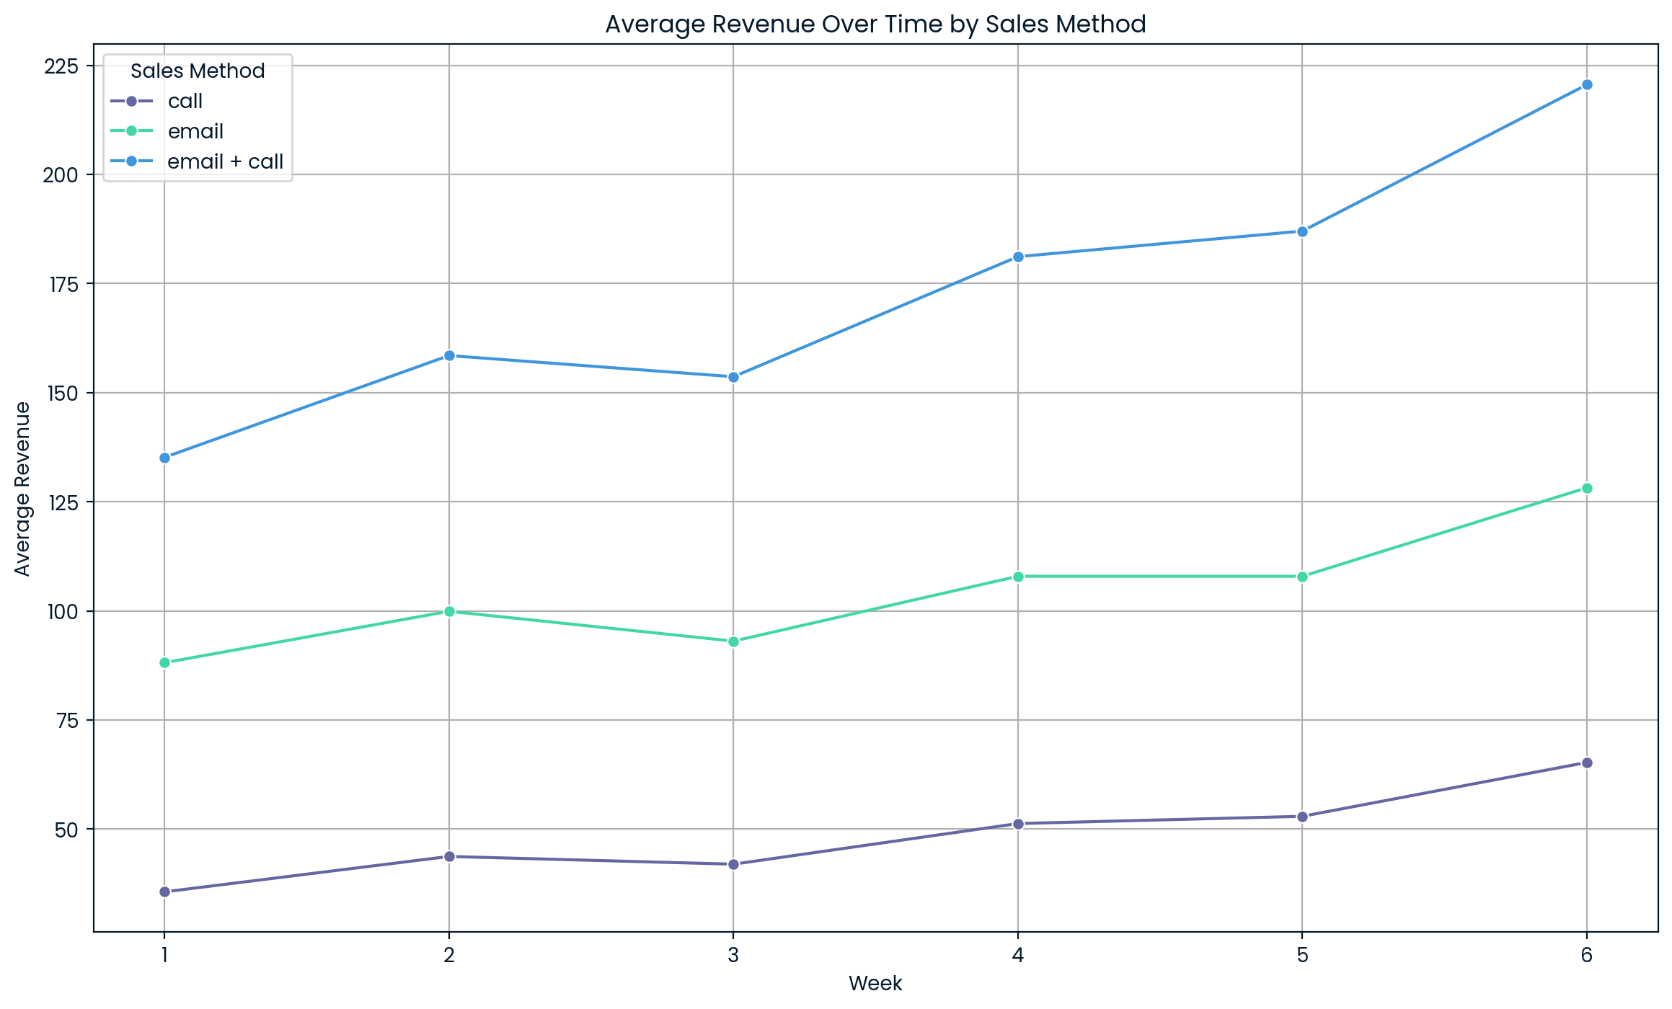
Efficiency metrics
Key metrics:
Focus on average revenue per customer and revenue per minute for ongoing evaluation of method performance.
Regularly track site visits and conversion rates to measure engagement driven by each method.
Initial Estimates:
Email + Call: $18.37 revenue per minute; $183.65 average revenue per customer.
Email: Minimal effort required; highly scalable.
Call: $1.59 revenue per minute; least effective.

Slide 6
Recommendations
Email + Call:
Continue for high-value customers.
Use for targeted campaigns where personalized interaction yields significant returns.
Email:
Leverage for broad outreach due to low effort and scalability.
Automate workflows to further reduce time and resource costs.
Call:
Discontinue or limit significantly, as it yields the lowest return on investment.

Slide 7
Future Actions
Refine customer segmentation for targeted outreach.
Pilot test hybrid methods for high-value customer segments.
Regularly monitor metrics to adapt strategies based on performance.

Slide 8
Thank You

